Slide 1
7FNCE040W
Business Analytics

Slide 2
Summary & Dispersion measures
Returns and Risks

Slide 3
Scales of Measurement
Nominal
Ordinal
Ratio
Interval
Notes:
In SPSS Interval & Ratio data are called Scale data
Nominal
The numbers serve only as labels or tags for identifying and classifying objects.
When used for identification, there is a strict one-to-one correspondence between the numbers and the objects.
The numbers do not reflect the amount of the characteristic possessed by the objects.
Examples: Male-female, User-nonuser, Occupations, Uniform numbers
Ordinal
A ranking scale in which numbers are assigned to objects to indicate the relative extent to which the objects possess some characteristic.
Can determine whether an object has more or less of a characteristic than some other object, but not how much more or less.
Any series of numbers can be assigned that preserves the ordered relationships between the objects.
Examples: Preference for brands, Social class, Hardness of minerals, Graded quality of lumber
Interval
Numerically equal distances on the scale represent equal values in the characteristic being measured.
It permits comparison of the differences between objects.
The location of the zero point is not fixed. Both the zero point and the units of measurement are arbitrary.
Any positive linear transformation of the form y = a + bx will preserve the properties of the scale.
Examples: Temperature scale, Grade point average, Attitude toward brands, Awareness of advertising
Ratio
Possesses all the properties of the nominal, ordinal, and interval scales.
It has an absolute zero point.
It is meaningful to compute ratios of scale values.
Only proportionate transformations of the form y = bx, where b is a positive constant, are allowed.
Examples: Units sold, Number of purchasers, Probability of purchase, Weight

Slide 4
Types of Data and Measurement Scales
Data
Non-metric or Qualitative
Nominal
Ordinal
Metric or Quantitative
Interval
Ratio

Slide 5
What are Central Tendency & Dispersion?
 | Basic Levels of Scales
Measurement | Nominal | Ordinal | Interval | Ratio
Central Tendency
Mode | Appropriate | Appropriate | Appropriate | Appropriate
Median | Inappropriate | More Appropriate | Appropriate | Appropriate
Mean | Inappropriate | Inappropriate | Most Appropriate | Most Appropriate
Dispersion
Frequency Distribution | Appropriate | Appropriate | Appropriate | Appropriate
Range | Inappropriate | More Appropriate | Appropriate | Appropriate
Standard Deviation | Inappropriate | Inappropriate | Most Appropriate | Most Appropriate
Notes:
Need to do the right analyses for the type of data
An important consideration in the type of scale used is the analysis that can be performed on the data.
Interval and ratio data allow more powerful methods of statistical analysis.
However, note that we cannot compare the absolute magnitude of interval scales if units are different.
Central tendency:
Mode: the most frequent occurring value for the variable.
Median: the category into which the 50th percentile response falls when all the responses are arranged from lowest to highest (or highest to lowest).
Mean: the simple average of the various responses pertaining to a variable.
Measures of dispersion: describe how the responses are clustered around the mean or a central value
Frequency distribution: the distribution of data pertaining to the response categories of a single variable
Range: a measure of dispersion of the responses; calculated as the difference between the largest and the smallest response values
Variance: a measure of the dispersion of responses around the mean; calculate it as the average of the squared deviations about the mean
Standard deviation: a measure of the dispersion around the mean; we calculate as the square root of the variance

Slide 6
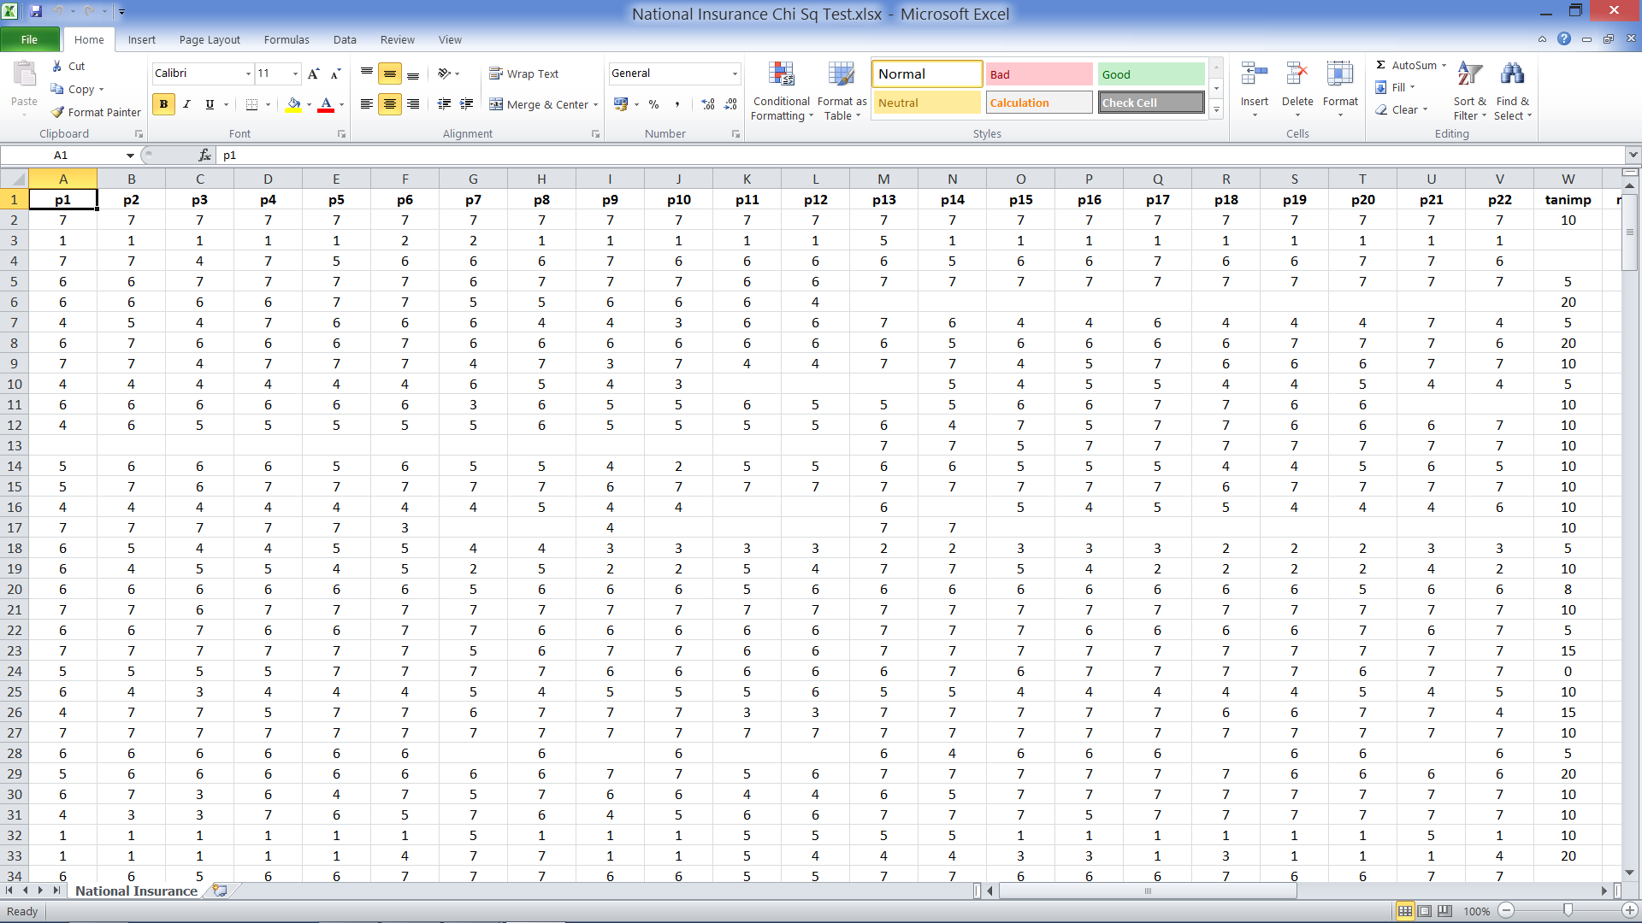
Open Excel File: National Insurance.xlsx
Notes:
This is a hypothetical data file which relates to the respondents’ feelings about National Insurance Company.
There are 285 respondents (rows) and 37 variables (Columns) which correspond to the items asked on the questionnaire.
Columns AL – AP are averages of:
Reliable (p1 – p5)
Empathy (p6 – p10)
Tangibles (p7 – p14)
Responsiveness (p15 – p18)
Assurance (p19 – p22)
Last columns – bins – will be explained later

Slide 7
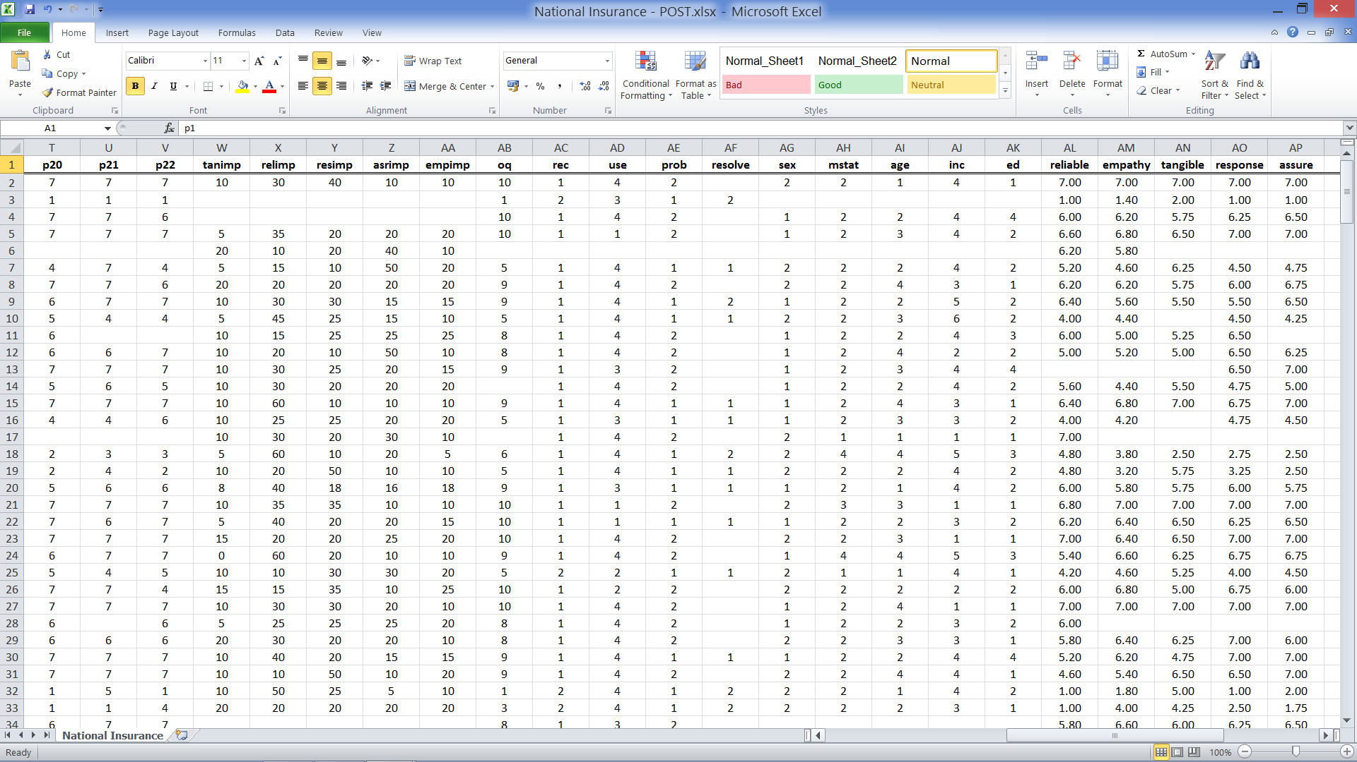
Demographic Variables
Notes:
Scroll over to columns AG:AK
Gender: {1 = male; 2 = female}
Your martial status: {1 = Single; 2 = Married; 3 = Widowed; 4 =Divorced}
Your age: {1 = Under 25; 2 = 25 – 44; 3 = 45 – 64; 4 = 65 or Over}
Your annual family income: {1= Under £10,000; 2 = 10,000 – 19,999; 3 = 20,000 – 29,999; 4 = 30,000 – 49,999; 5 = 50,000 – 64,999; 6 = 65,000 or over}
The highest level of schooling you completed: {1 = Secondary school or less; 2 = Some University; 3 = University undergraduate; 4 = Post graduate education}

Slide 8
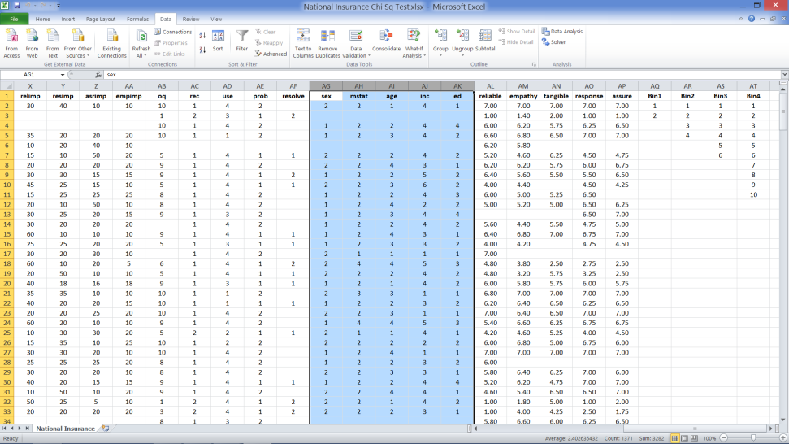
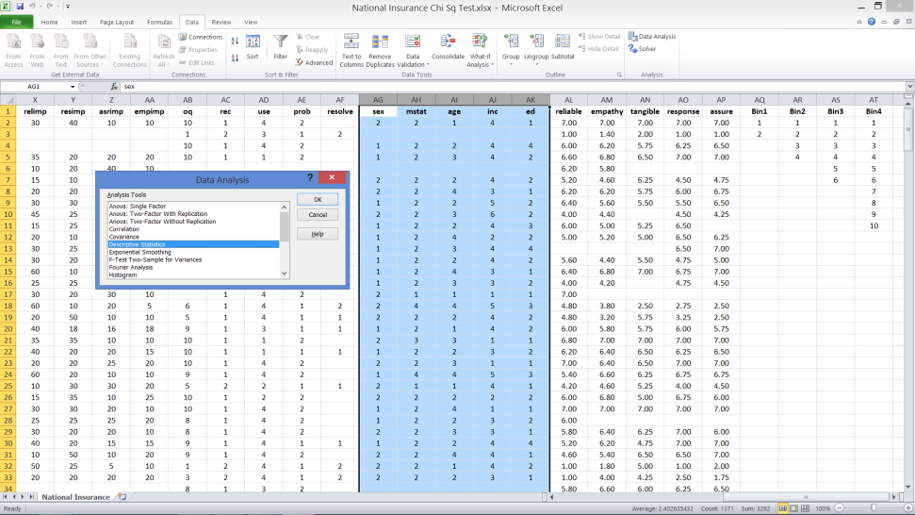
Demographic Profile Needed: Columns AG - AK
Go to Data Tab
Click on Data Analysis
Select Descriptive statistics from dialog box
Notes:
Jill Baxter, vice president of customer service, for National Insurance Company and her assistant, Tom Kurtis, want you to develop and briefly describe the demographic profile of the survey respondents.
Go to Data Tab
Click on Data Analysis
Descriptive statistics

Slide 9
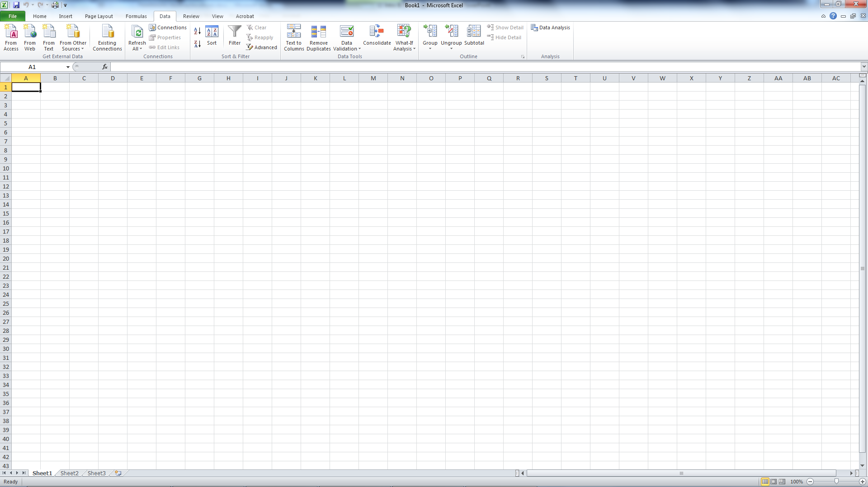
If Data Analysis is Not Available

Slide 10
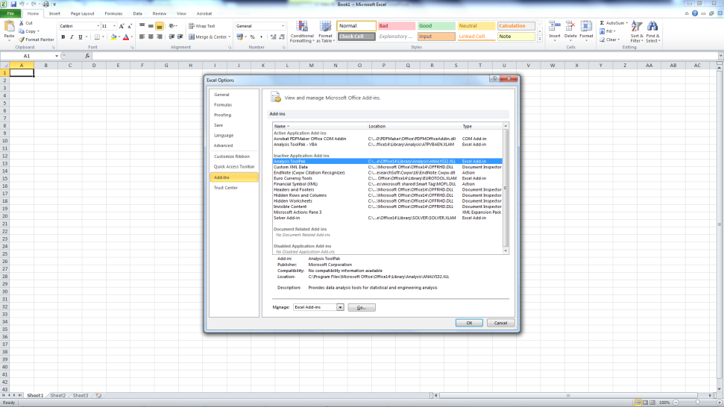
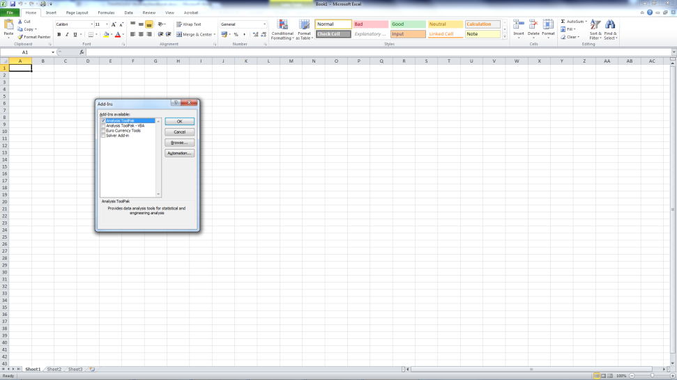
Next Steps
Notes:
File
Options
First Screen
Add-ins
Select Analysis Toolpak
Click on ‘Go’
Next Screen
Tick Analysis Toolpak
Click ‘OK’

Slide 11
Demographic Profile Needed: Columns AG - AK
Go to Data Tab
Click on Data Analysis
Select Descriptive statistics from dialog box
Notes:
Jill Baxter, vice president of customer service, for National Insurance Company and her assistant, Tom Kurtis, want you to develop and briefly describe the demographic profile of the survey respondents.
Go to Data Tab
Click on Data Analysis
Descriptive statistics

Slide 12
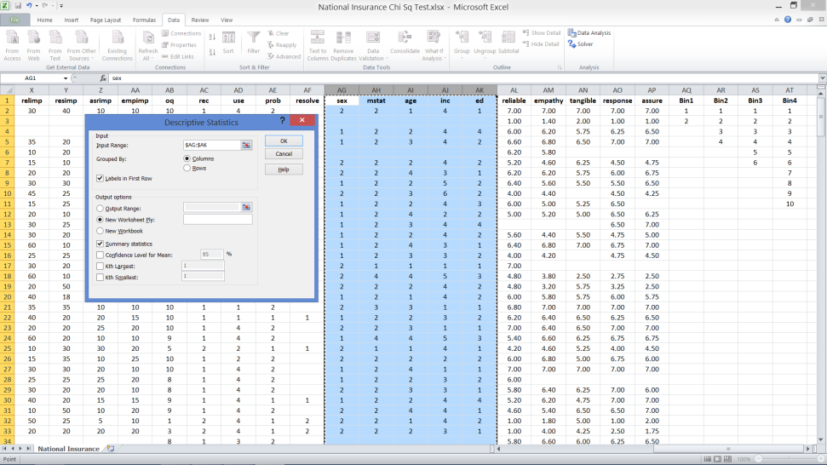
Descriptive Statistics
Input range: ($AG$1:$AK$286)
Variables are in columns
Tick box for labels if Row 1 is included in the ‘Input Range’
Output in a new worksheet
Tick Summary Statistics
OK
Notes:
Input range should include all 5 highlighted columns: sex, marital status, age, income, education (£AG£1:£AK£286)
Variables are in columns
Tick box for labels in the first row, if the top row (with labels) is included in the ‘Input Range’
Output should be in a new worksheet
Tick Summary Statistics
OK

Slide 13
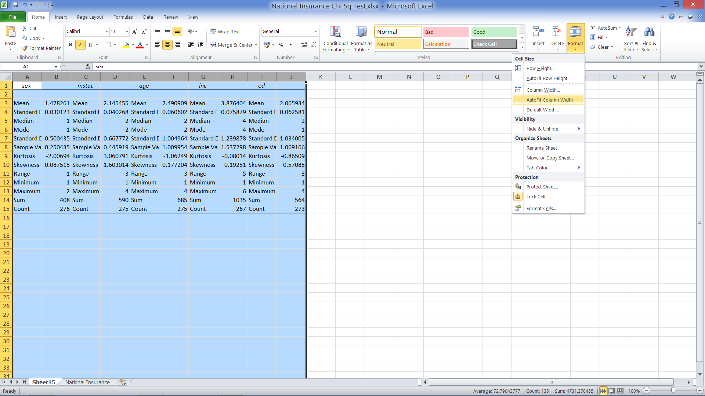
To Read All Output

Slide 14
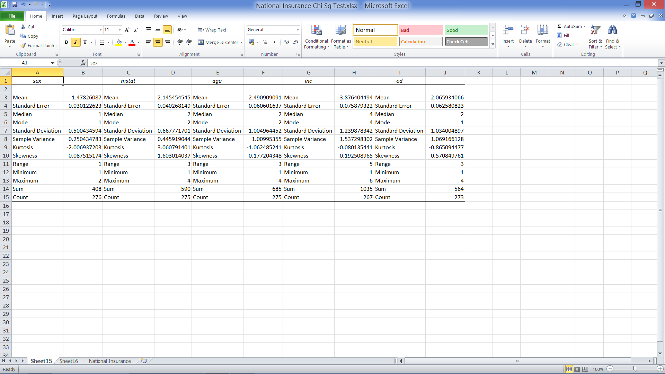
Output

Slide 15
What Makes Sense?
Nominal Data?
Ordinal Data?
Mode, Median, Mean?
Sex
Marital Status
Age
Income
Education
Mode: All
Median: Ordinal only
Mean: None

Slide 16
Results
 | Gender | Marital Status | Age | Income | Education
Mode | 1 | 2 | 2 | 4 | 1
Median |  |  | 2 | 4 | 2
What do these numbers mean?
What else would you like to know?
Why?
Notes:
Why look at frequency data?
Great first look at nominal and ordinal data
Good first look at most interval data
Considerations
Mode: Is this value most common by 1 response, or many?
Median: Is the middle response near the top, bottom, or middle of the scale?

Slide 17
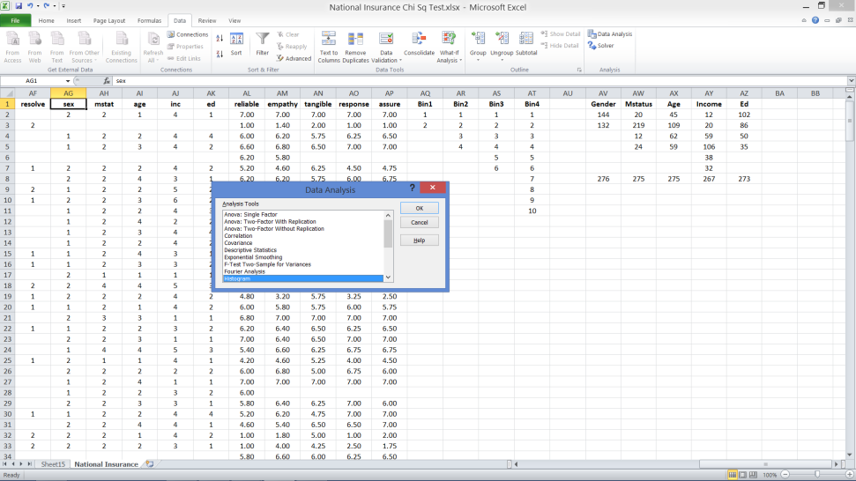
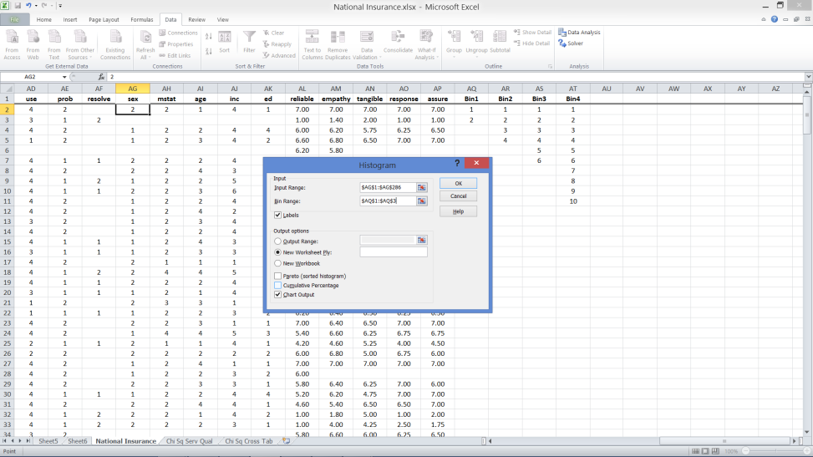
Frequencies & Histograms
From Data Analysis
Dialog Box
Notes:
Click on Data tab
Select Data Analysis
Select Histogram
Input range: Highlight column for sex (AG1:AG286)
Bin range: Highlight Bin1 (AQ1:AQ3 because only 2 possible responses)
Tick labels box if row 1 is included in input range and bin range
Tick new worksheet
Tick chart output
OK

Slide 18
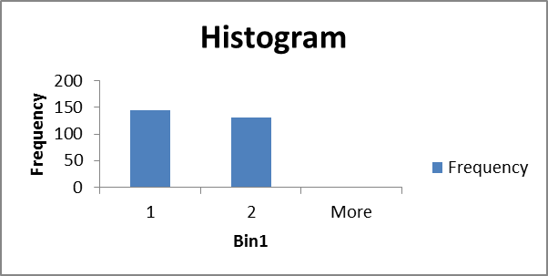
Output
Frequencies
Histogram
Bin1 | Frequency
1 | 144
2 | 132
More | 0

Slide 19
Repeat for Next 4
 | Gender |  | Marital Status |  | Age |  | Income |  | Education
 | Cat | Count | Cat | Count | Cat | Count | Cat | Count | Cat | Count
 | 1 | 144 | 1 | 20 | 1 | 45 | 1 | 12 | 1 | 102
 | 2 | 132 | 2 | 219 | 2 | 109 | 2 | 20 | 2 | 86
 |  |  | 3 | 12 | 3 | 62 | 3 | 59 | 3 | 50
 |  |  | 4 | 24 | 4 | 59 | 4 | 106 | 4 | 35
 |  |  |  |  |  |  | 5 | 38
 |  |  |  |  |  |  | 6 | 32
Total |  | 276 |  | 275 |  | 275 |  | 267 |  | 273
Notes:
Be sure to select the appropriate bin for each variable – should match the number of possible response options.

Slide 20
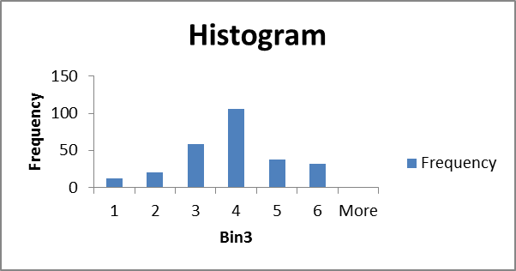
An Example: Income Distribution
Table
Chart
Range | Code | Count
0 - £10,000 | 1 | 12
£10,000 – £19,999 | 2 | 20
£20,000 – £29,999 | 3 | 59
£30,000 - £49,999 | 4 | 106
£50,000 - £64,999 | 5 | 38
£65,000 or over | 6 | 32
Total |  | 267
Notes:
Note that the interpretations of each ‘bin’ are not provided by the Excel output.
Why doesn’t total equal 276 as for sex?

Slide 21
END OF BITE SIZE 1 part 2

Slide 22
WEEK 1
Week 1 BITE SIZE 1. part 3

Slide 23
Now we will use SPSS to conduct the Analysis
FROM DATA FOLDER IN BLACKBOARD SELECT FILE
‘National Insurance.SAV

Slide 24
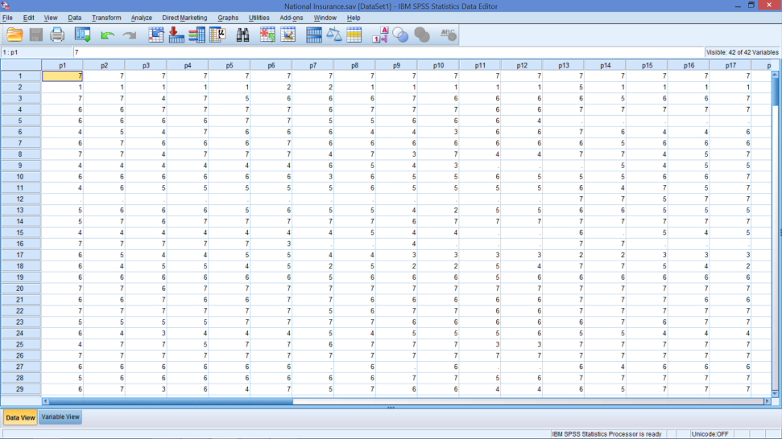
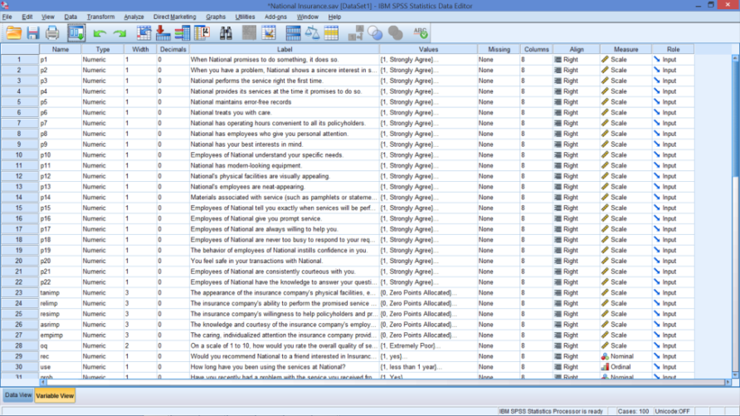
Open SPSS File: National Insurance.SAV
Data View
Variable View
Notes:
Hopefully, the next exercises will convince you that SPSS is superior to Excel.
But, Excel can do a lot of analyses if there are no other options.
While the Data view looks just like the Excel worksheet, the variable view is what makes SPSS user friendly.

Slide 25
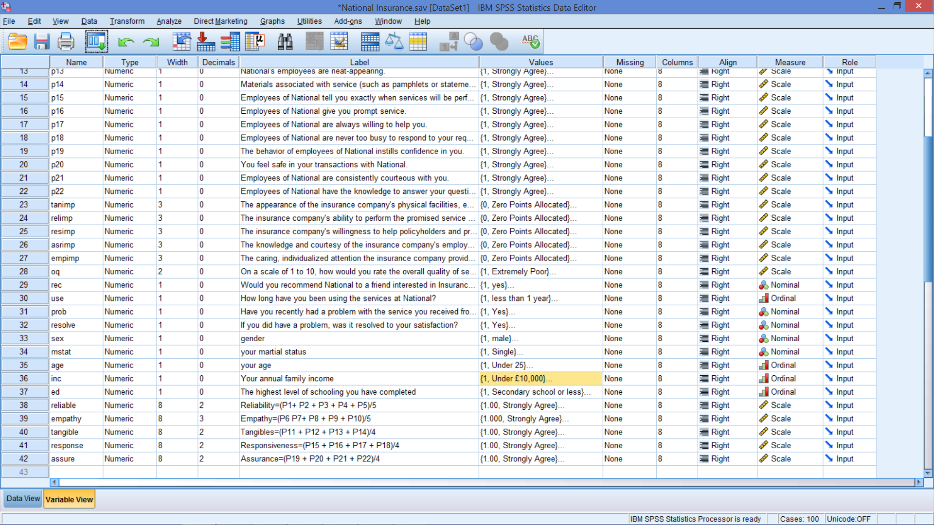
Note Computed Variables
Notes:
Computed variables are created by:
Select Transform
Click Compute
Type ‘reliable’ in Target Variables box
Click on parentheses () and move it to the numeric expressions box
Click p1 and move it inside the parentheses in the numeric expressions box
Click on the ‘+’ sign
Click on p2 and move it to the numeric expressions box and then click on the ‘+’ sign
Repeat this for p3, p4, and p5 and then divide the whole expression by 5
Click on Type & Label under the Target Variable box and type Overall Reliability – constructed from the 5 rating scales in the label box
Click OK

Slide 26
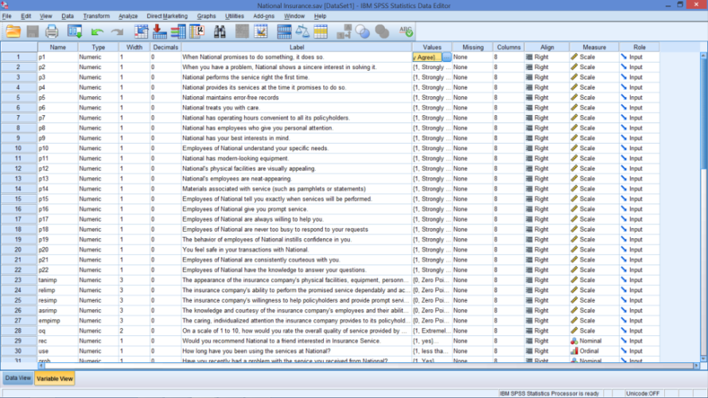
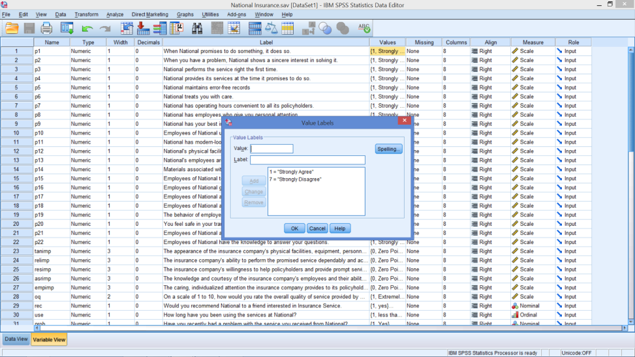
Look at P1 (First Row)
Highlight Value Column
Click on Box with …
Notes:
Looking at the Value column
Can see how responses are coded
Great feature
Also note that there is a missing column.
In this case, missing responses are blank
But, some data files code missing values as 999, for example. This will let SPSS know that these are just place holders and should not be used in any calculations.
Note, too, that there is a column for the type of data
Interval and ratio data are considered Scale data

Slide 27
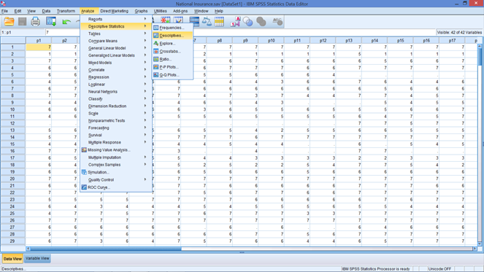
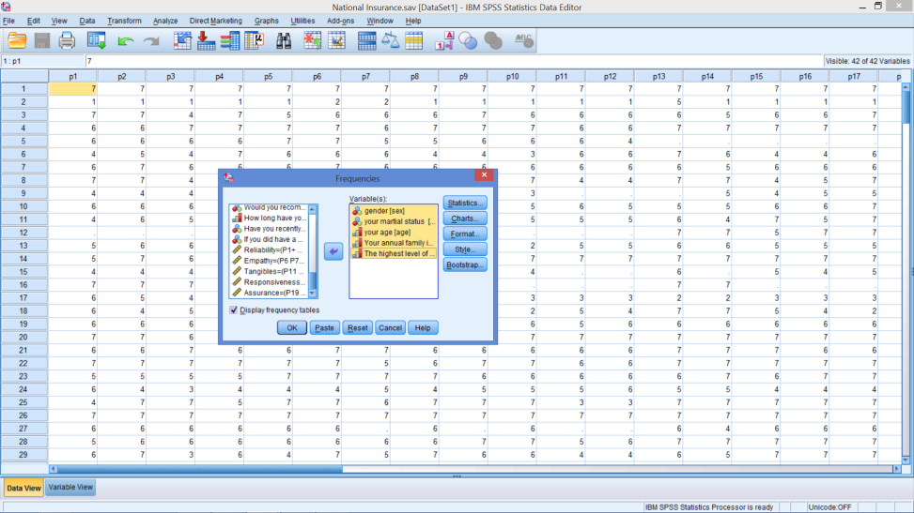
Do Same tasks with SPSS
Analyse → Descriptive Statistics → Frequencies
Select variables
Notes:
Analyse
Descriptive Statistics
Frequencies
Highlight 5 demographic variables (gender – education)
Click on arrow, moving them to other box

Slide 28
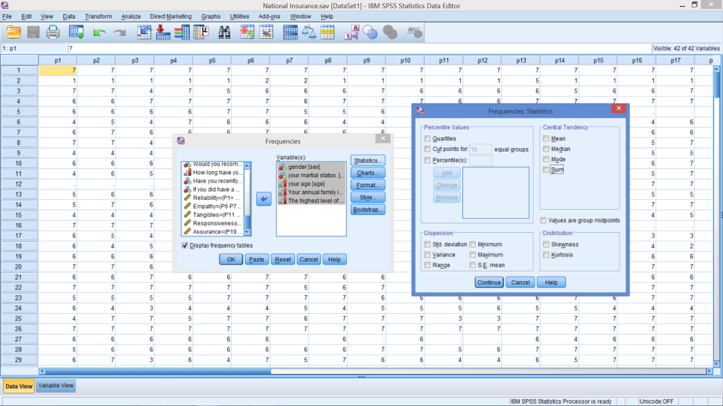
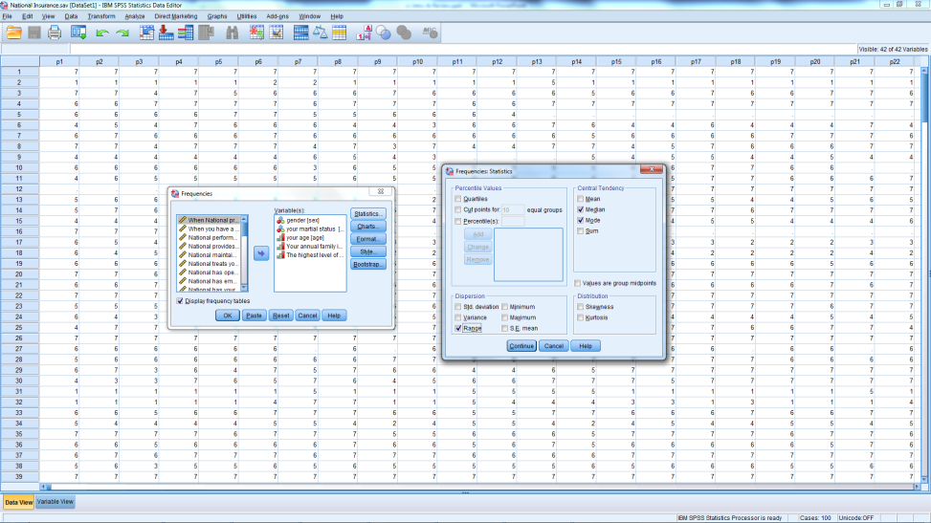
Statistics
From Statistics Box
What do we want?
Then click Continue
Notes:
Check only those that apply to the data given
If you choose all the options, be careful with the output used

Slide 29
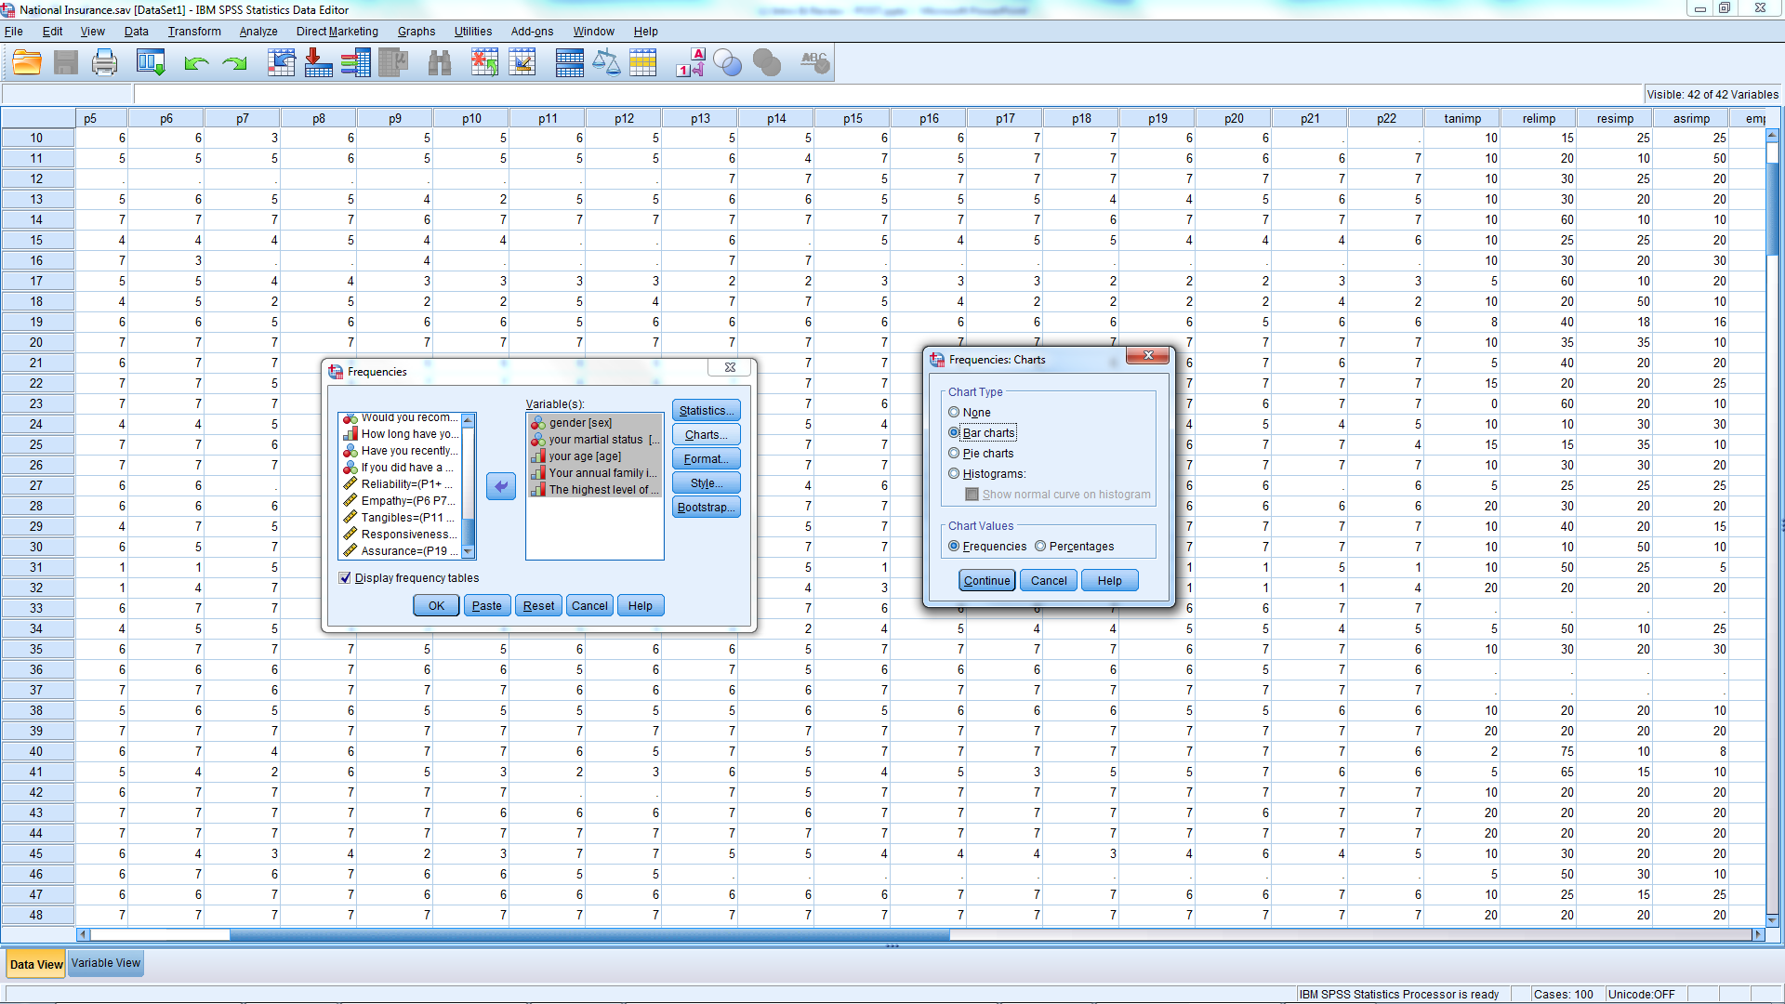
Chart Output – From Charts
Notes:
Select bar chart or histogram
Bar char tis preferred because it will use the labels from variable view
Make sure ‘Display Frequency Tables’ is ticked

Slide 30
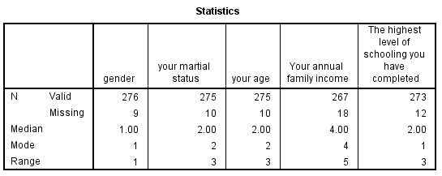
Statistics
What do these statistics mean?
Notes:
What is the difference between valid sample and total (286)?
Remember the median and range of nominal data have no meaning!

Slide 31
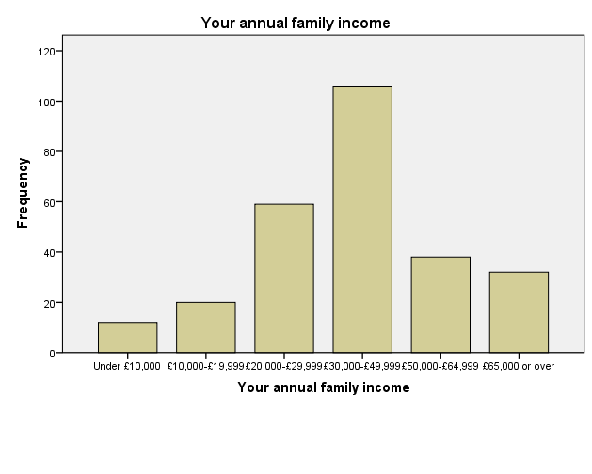
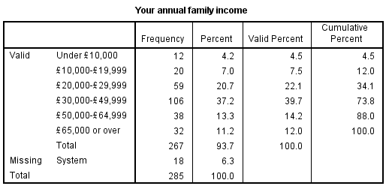
Income
Statistics
Frequency Chart

Slide 32
Questions to Answer
What percentage of sample are women?
What percentage have been with National for 2 years or more? (See column 30)
What is the distribution of quality of service? (See column 28)
What percentage rate overall quality of service at 5 or greater?
What are the mean and variance of quality of service?
Is there a difference between men & women on perceptions of service quality?
1
2
3
4
5
6

Slide 33
Gender
Statistics
Chart
Notes:
Insert your output into this slide, if you want, then save it to your own drive.
What percentage of sample are women?
47.8%

Slide 34
Questions to Answer
What percentage of sample are women?
What percentage have been with National for 2 years or more? (See column 30)
What is the distribution of quality of service? (See column 28)
What percentage rate overall quality of service at 5 or greater?
What are the mean and variance of quality of service?
Is there a difference between men & women on perceptions of service quality?
1
2
3
4
5
6

Slide 35
Time with Company
Statistics
Chart
Notes:
What percentage have been with the company for 2 years or more?
100 – 19.2 = 80.8%

Slide 36
Questions to Answer
What percentage of sample are women?
What percentage have been with National for 2 years or more? (See column 30)
What is the distribution of quality of service? (See column 28)
What percentage rate overall quality of service at 5 or greater?
What are the mean and variance of quality of service?
Is there a difference between men & women on perceptions of service quality?
1
2
3
4
5
6

Slide 37
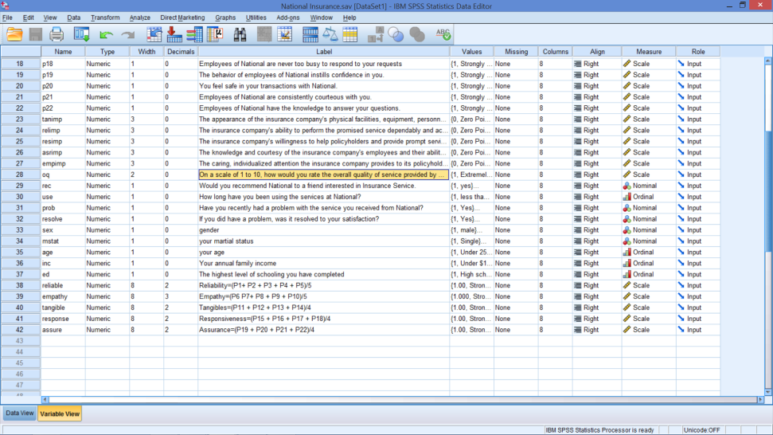
Overall Quality of Service
Variable view – row 28
From Variable View
Scale: 1 - 10
1 = Extremely poor
10 = Extremely good
Run appropriate Descriptive Statistics

Slide 38
Output
Statistics & Frequencies
Chart Output
Notes:
What percentage rate overall quality of service at 5 or greater?
100 – 9.0 = 91.0%
What is the distribution of quality of service?
See chart
What are the mean and variance of quality of service?
Mean: 7.8
Variance: 5.433

Slide 39
Questions to Answer
What percentage of sample are women?
What percentage have been with National for 2 years or more? (See column 30)
What is the distribution of quality of service? (See column 28)
What percentage rate overall quality of service at 5 or greater?
What are the mean and variance of quality of service?
Is there a difference between men & women on perceptions of service quality?
1
2
3
4
5
6

Slide 40
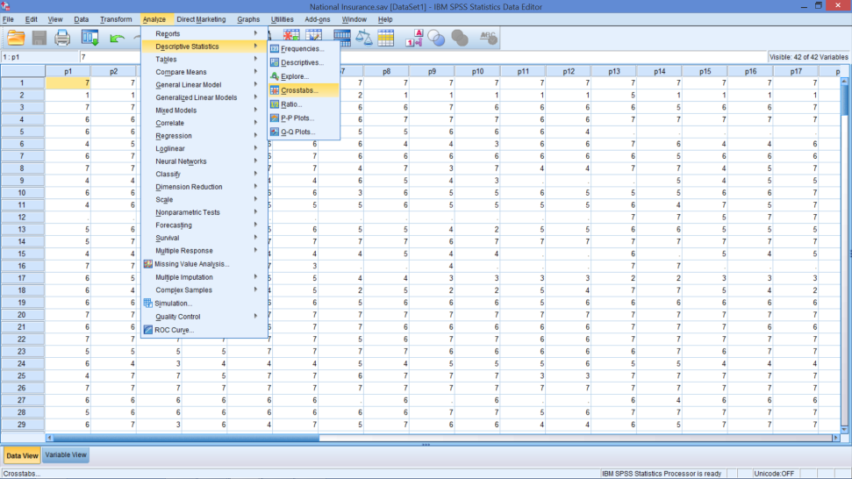
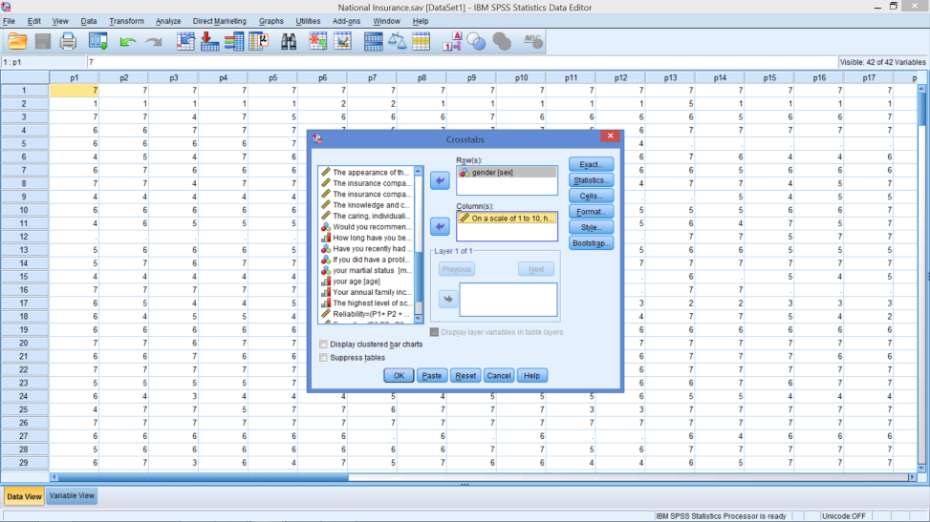
Cross Tabulation
From Descriptive Statistics → Cross Tabs
Add Two Variables

Slide 41
Crosstabs
Notes:
Why are there 263 responses here, instead of 268 who rated National’s quality of service or 276 who provided their gender?

Slide 42
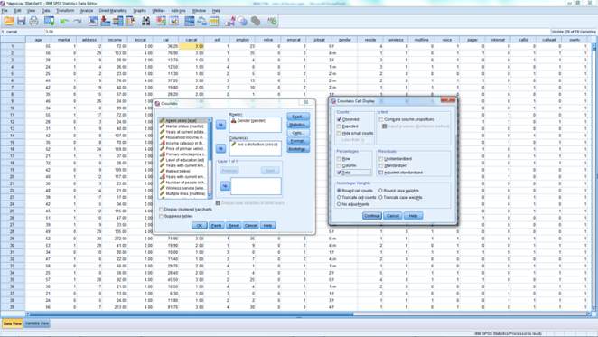
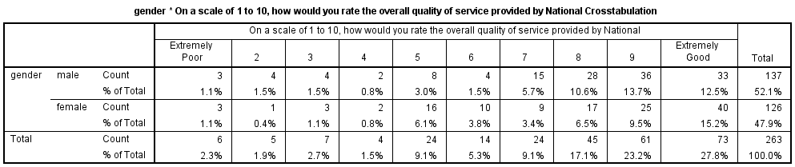
May Want Percentages

Slide 43
END OF SESSION 1 -BITE SIZE 3

